Slide 1
Comparison of DFT, FFT, and QFT
Ryan So
12/10/2025
Digital Signal Processing

Slide 2
Contents
Summary of DFT and FFT
Comparison Between the 3
Quantum Computing
Demo
What is QFT (Pros and Cons)
Conclusion
01
04
02
05
03
06
Company Name

Slide 3
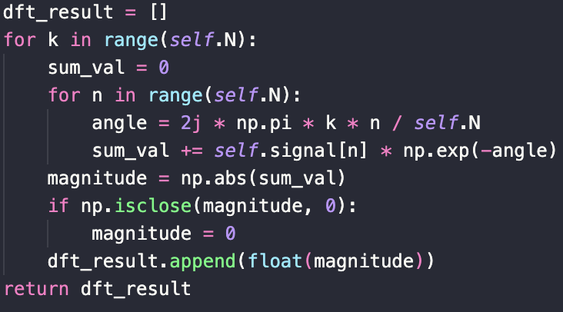
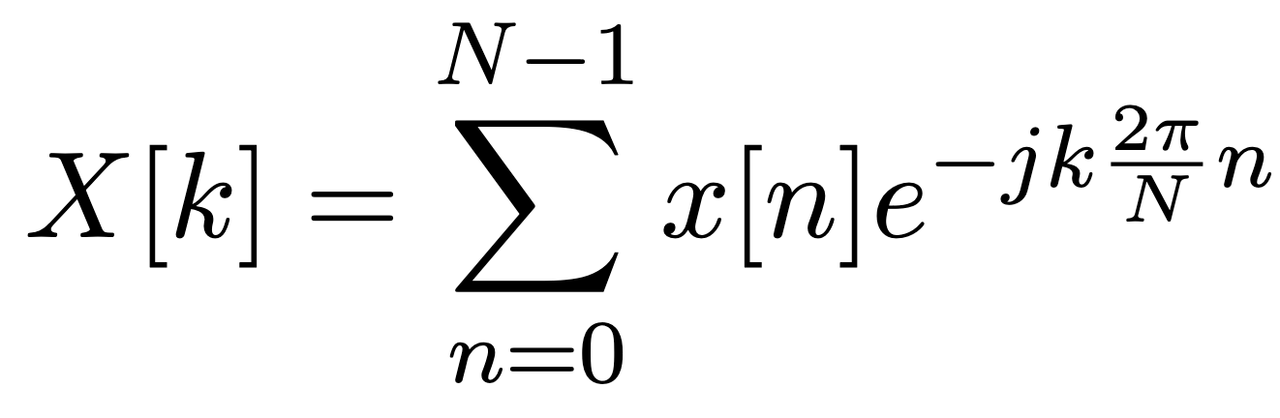
DFT
Given a discrete signal, transform the signal into discrete frequencies.
Comparison of DFT, FFT, and QFT

Slide 4
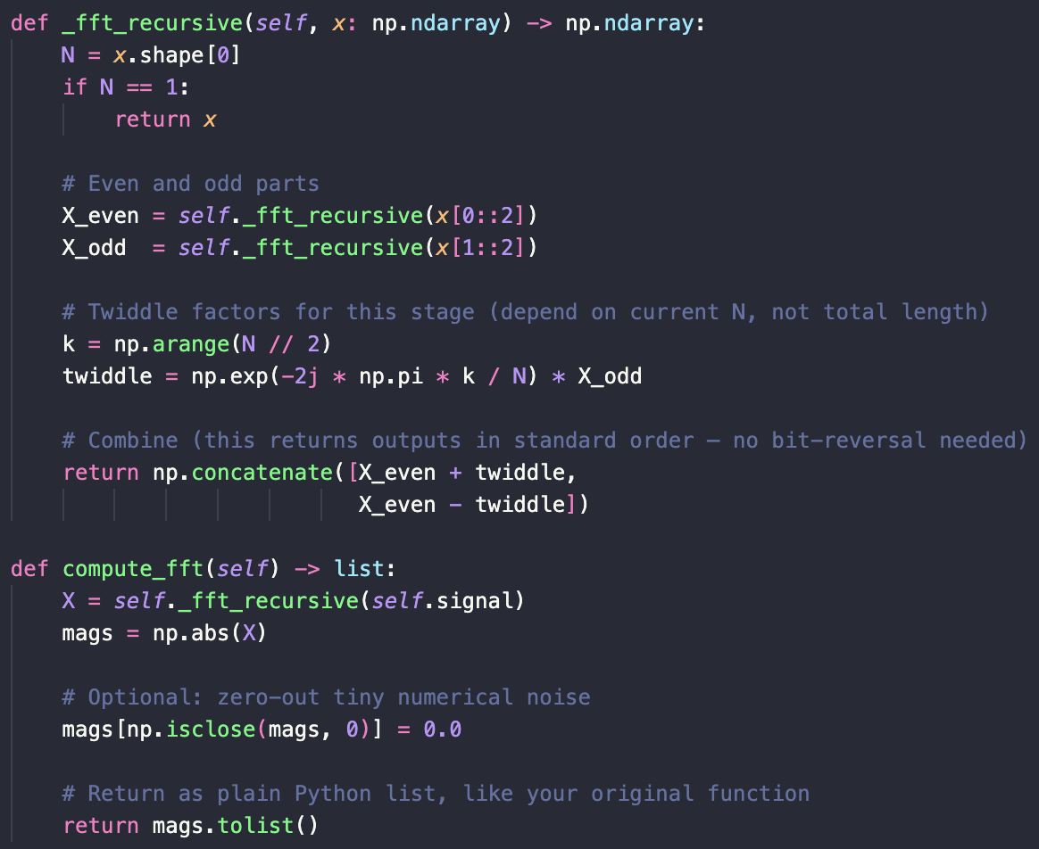
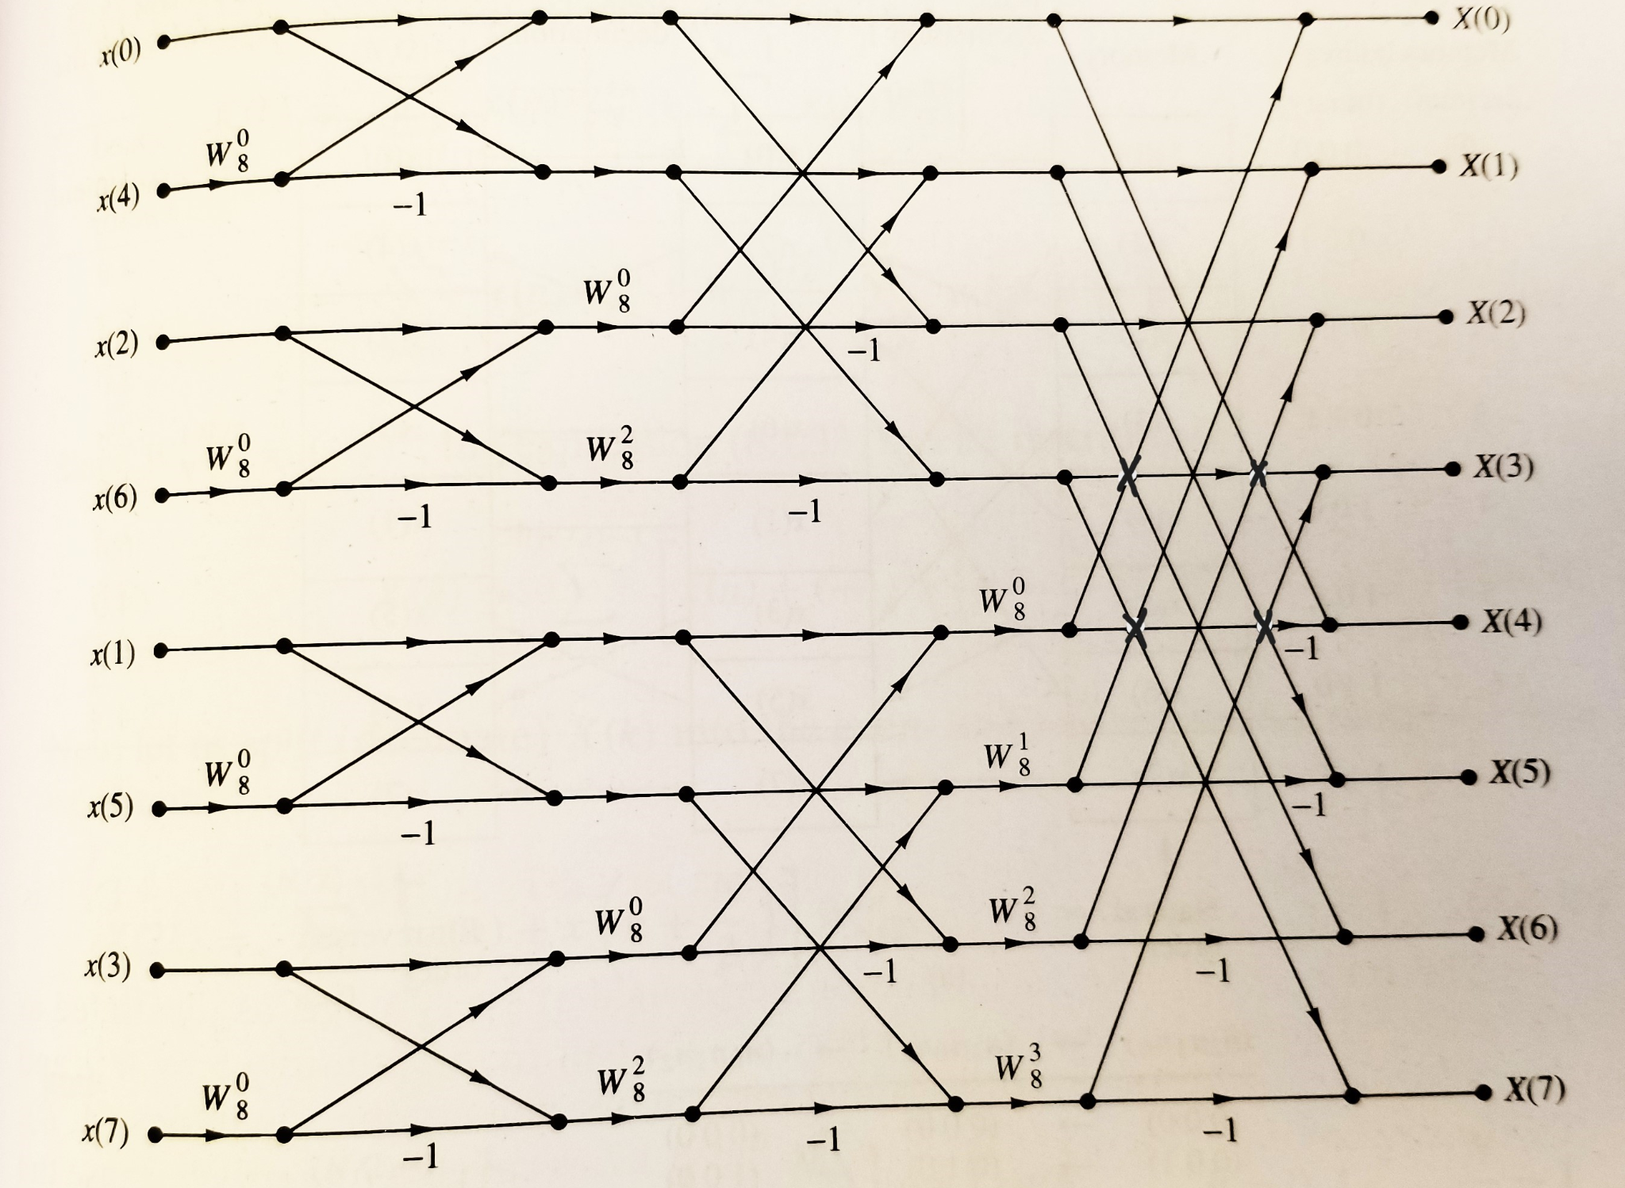
Radix-2 FFT
A derivation of the DFT by dividing the samples, performing butterfly operations, and conquering them to represent the input signal as it’s frequencies.
Comparison of DFT, FFT, and QFT

Slide 5
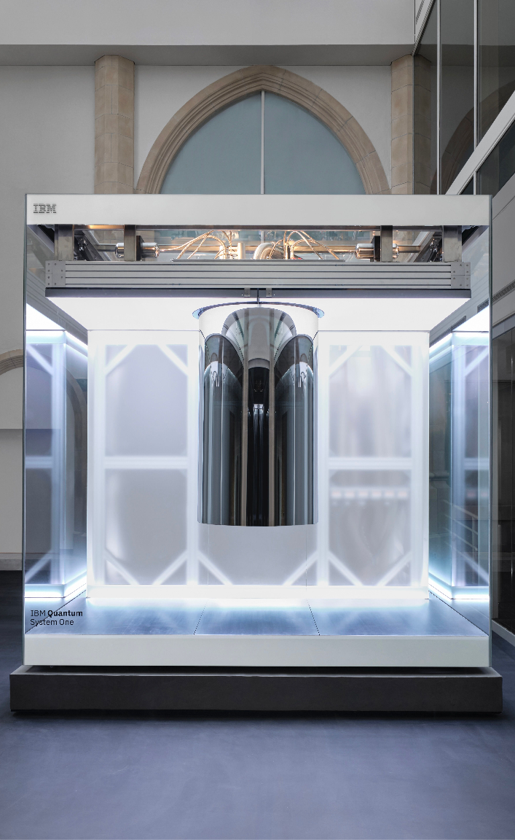
Quantum Computing
RPI’s quantum computer works by perform gates on qubits, similar to how we perform and, or, and not gates on bits.
All gates are rotations of qubits in the x, y, and z direction.
Measurements are taken to collapse the qubits to a 0 or 1. The act of collapsing is a probabilistic measurement which becomes apparent later.
Measuring a measured state will return the same result.
Depending on the number of “shots”, this process is done that many times.
Comparison of DFT, FFT, and QFT

Slide 6
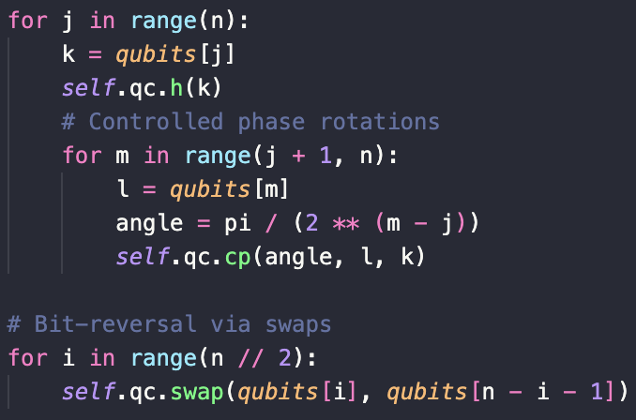
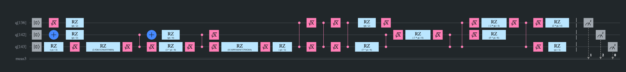
QFT
Initialize the qubits with given input by normalizing input and store the amplitude.
Multiply each amplitude with a phase rotation. (twiddle factor)
Bit reverse as this returns the inverse of what we want.
Comparison of DFT, FFT, and QFT

Slide 7
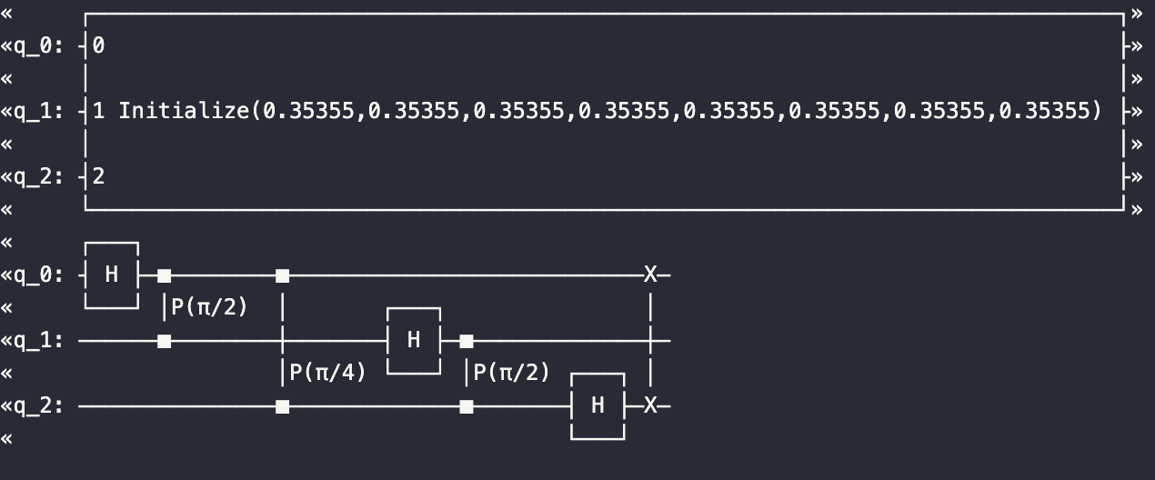
Pros and Cons
Pros | Cons
Algorithm is much faster as samples are stored as amplitudes. Memory efficient. | Big overhead with amplitude encoding. Noise and decoherence destroys the structure. Energy heavy. Depends on System One’s server response
Comparison of DFT, FFT, and QFT

Slide 8
Comparison Between the 3
Methods | DFT | Radix-2 FFT | QFT
Time complexity | O(n^2) | nlog(n) | (log(n))^2
Requirements | None | 2^n samples | 2^n samples
I/O Bound? | No | No | Yes
Simple? | 1 | 2 | 3
Comparison of DFT, FFT, and QFT

Slide 9
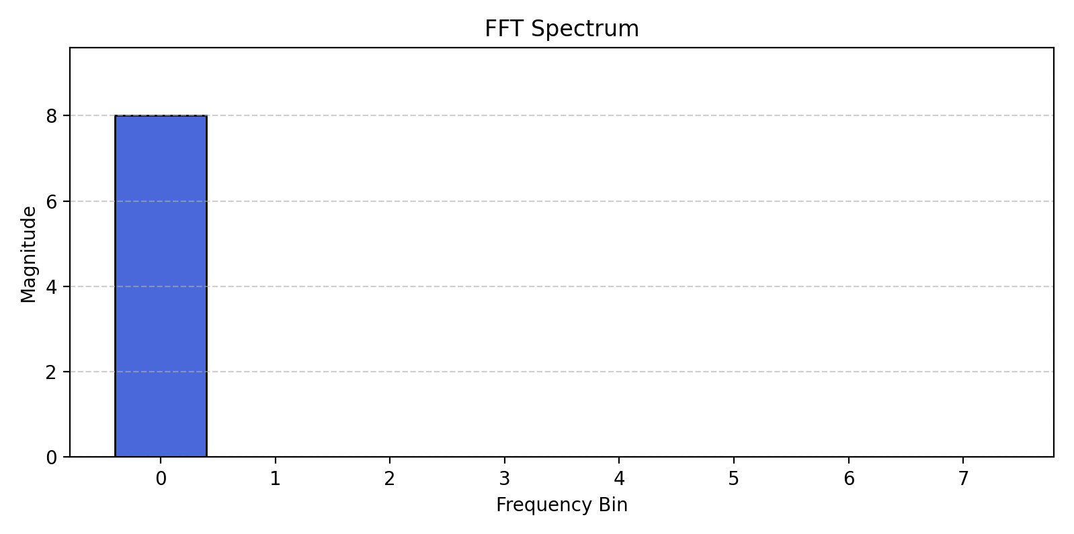
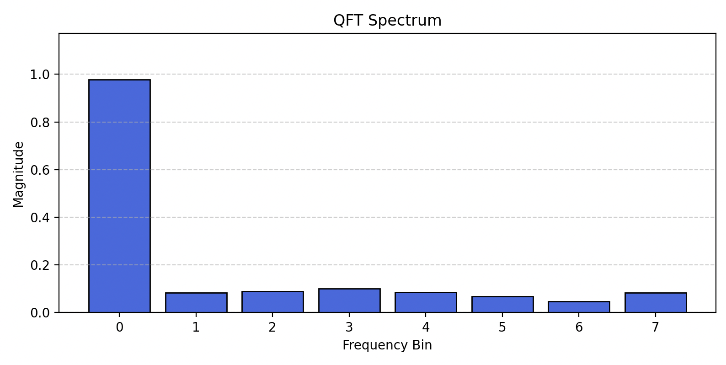

Demo with simple signal
x[n] = [1, 1, 1, 1, 1, 1, 1, 1]
Comparison of DFT, FFT, and QFT

Slide 10
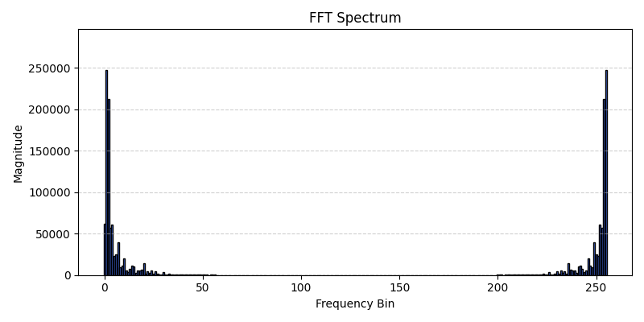

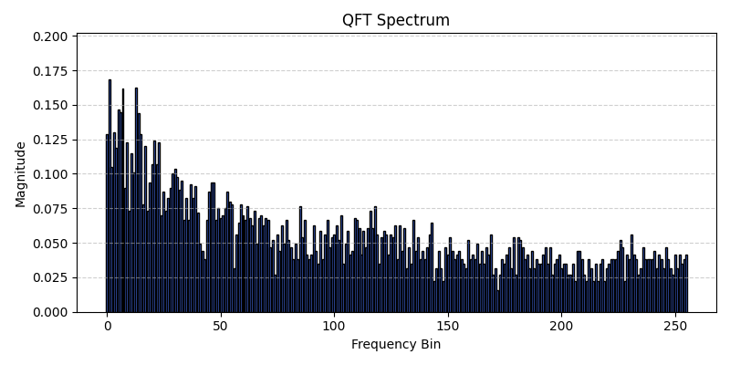
Demo with C major chord
FFT computation time: 0.0007379055023193359 seconds
DFT computation time: 0.03589296340942383 seconds
QFT computation time: 5.973768949508667 seconds
Comparison of DFT, FFT, and QFT

Slide 11

Conclusion
Although QFT and quantum computing in general promises a lot especially when it comes to runtime speedup, it falls short in a lot of areas. From noisy systems to long queue times, quantum computing needs a lot to go right and very little to go wrong. If one day we find a way to circumvent all these hurdles, quantum computing could be a step in the next big jump in technology. For now, it serves as a researcher’s best friend.
Comparison of DFT, FFT, and QFT

Slide 12
Sources
Introduction to Qiskit | IBM Quantum Documentation,” IBM Quantum Documentation, 2017. https://quantum.cloud.ibm.com/docs/en/guides
Oakes, K. (2025, September 15). Lec6-DFT. Piazza. https://piazza.com/class_profile/get_resource/mdenb3m6wean7/mfljlrzwpdt44m
Oakes, K. (2025, October 9). Lec-13-FFT-Radix-2. Pizza. https://piazza.com/class_profile/get_resource/mdenb3m6wean7/mgjvtpjcvur56g
T. G. Wong, "Quantum Fourier Transform," in *Introduction to Classical and Quantum Computing*, Chapter 7.7, 2023. [Online]. Available: https://cs.uwaterloo.ca/~watrous/QC-notes/. Accessed: Dec. 10e, 2025.
My github for this project:
https://github.com/ryanso128/DSP_Final_Project
Comparison of DFT, FFT, and QFT

Slide 13
Questions?
Comparison of DFT, FFT and QFT

